Slide 1
Title: Temperature sensing Security gate
By: Grp 10
Varun Gattu
Deraj M
Raghav Menon
Sathiyanarayanan

Slide 2
Inspiration
Generally, security guards check for temperature in malls and other locations and easily portable.
With the rise in COVID cases, these guards must now deal with hundreds of people, making them more vulnerable. As a result, we may utilize this product while being safe.

Slide 3
Working
We'll use an infrared sensor to detect the temperature.
The gate opens if the temperature is less than 99 degrees Fahrenheit.
As a result, time is saved and the guard is kept safe.

Slide 4
Challenges we ran into
We attempted but failed to integrate QR code verification for vaccination certificates.
When we came to creating the product, we ran across several issues.

Slide 5
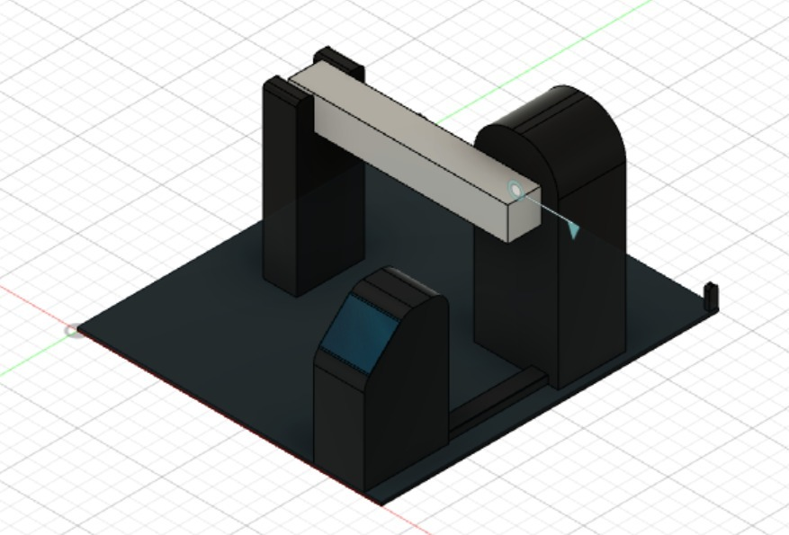
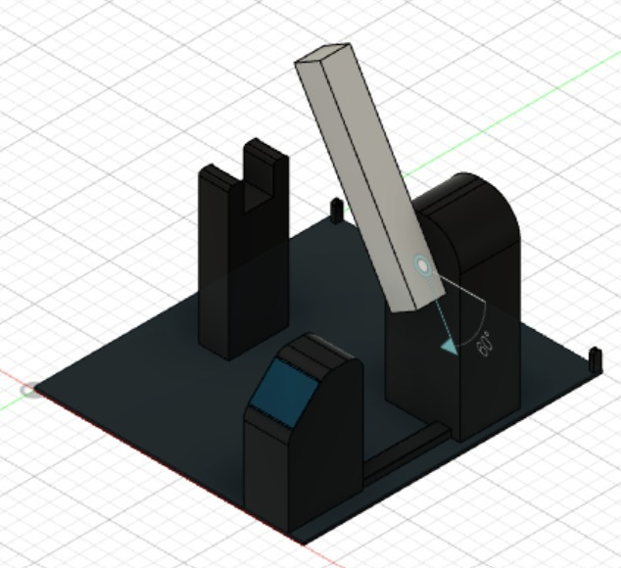
Model

